Slide 1
Definition of the WCNPO Striped Marlin Management Unit
Jon Brodziak
ISC Billfish Working Group Chair
Jon.Brodziak@NOAA.GOV

Slide 2
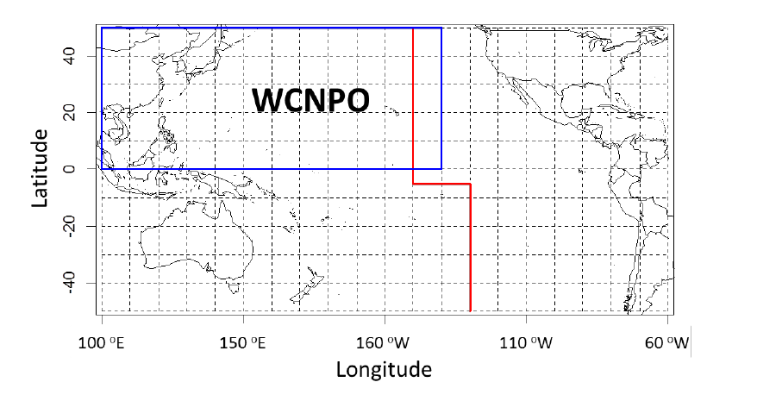
WCNPO Striped Marlin Management Unit for 2015 Assessment Update

Slide 3
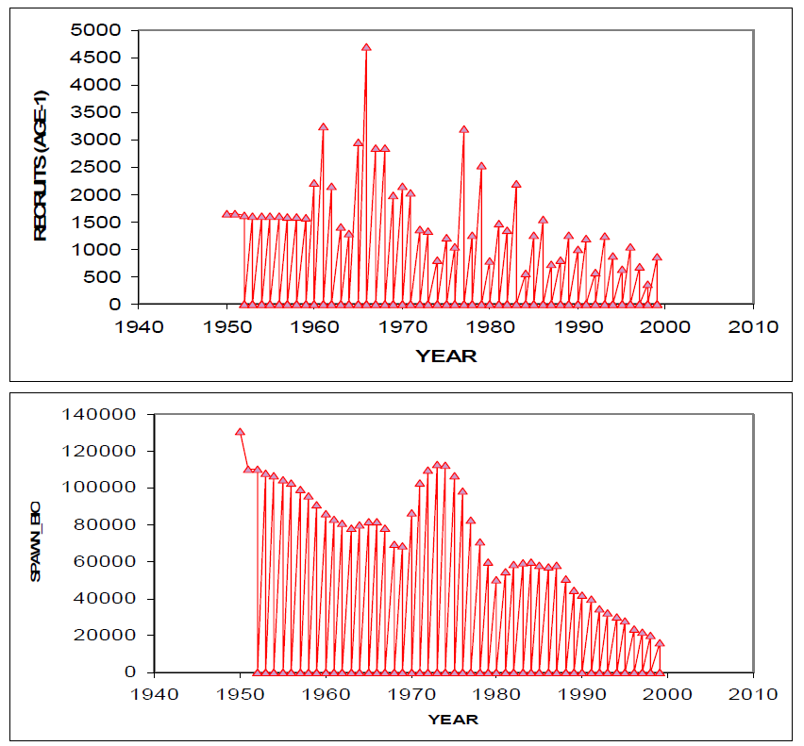
North Pacific Striped Marlin Stock Assessment History
2007 Entire North Pacific, 1952-1999 (ISC7/SWOMAR-1/WP2)

Slide 4
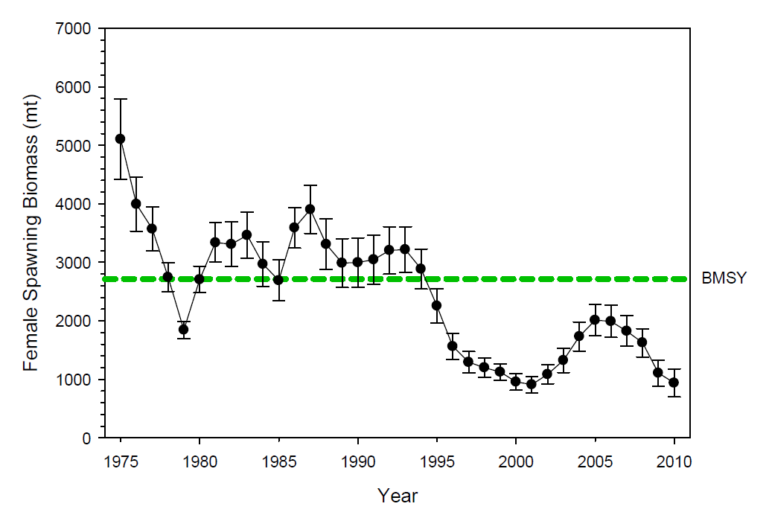
Assessment History
2011 Western and Central North Pacific,
1975-2010 (ISC12/BILLWG-1/Report)

Slide 5
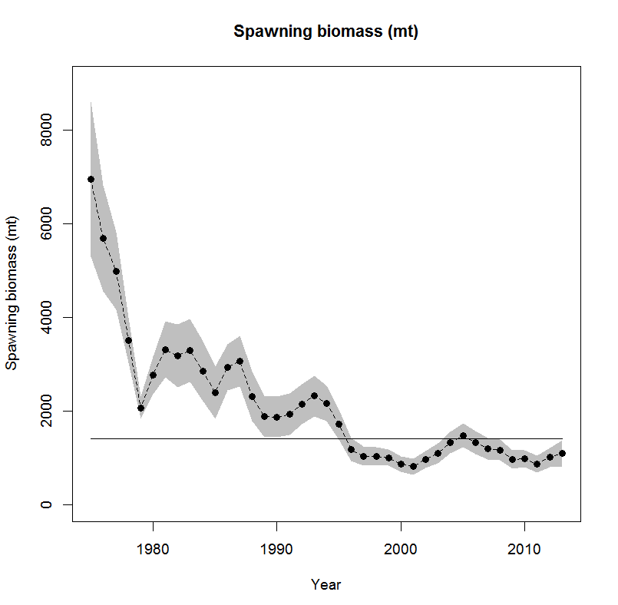
Assessment History
2015 Western and Central North Pacific,
1975-2013 (ISC15/BILLWG/MLS/SAR)

Slide 6
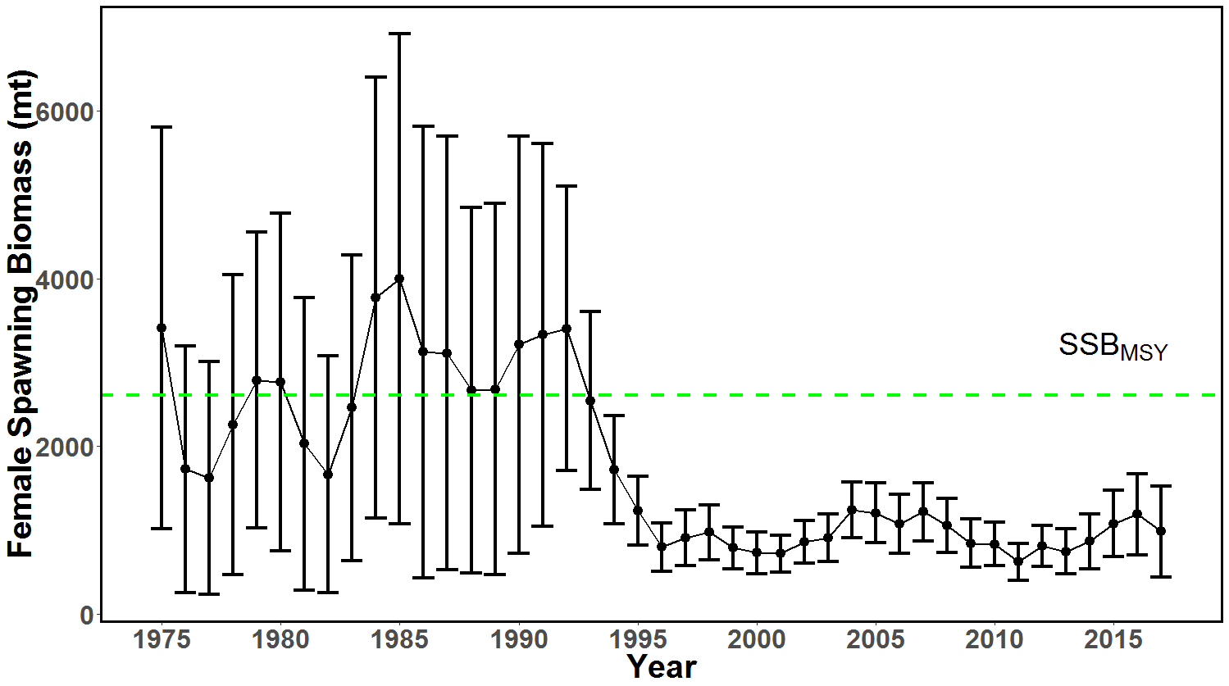
Current Assessment
2019 Western and Central North Pacific,
1975-2017 (ISC19/BILLWG/MLS/SAR)

Slide 7
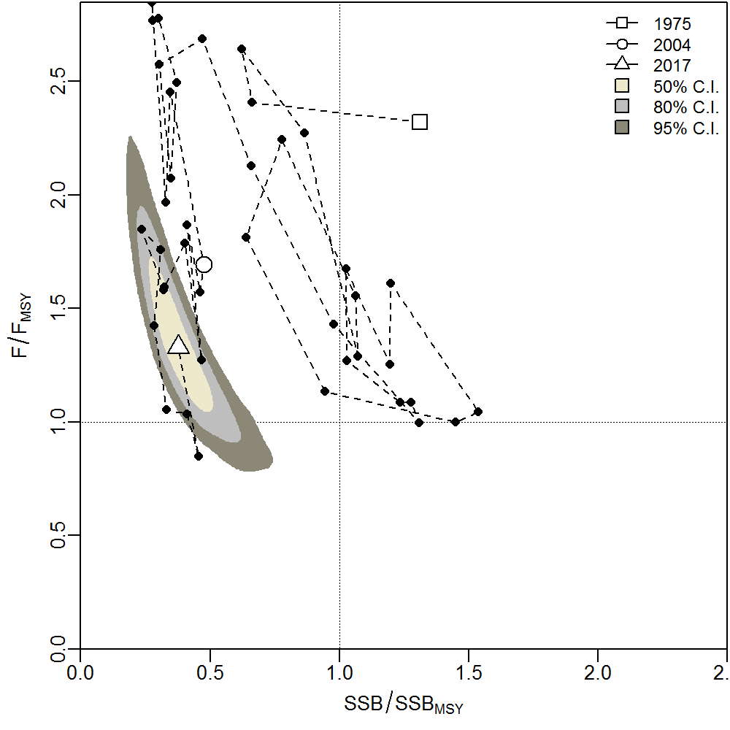
Current Assessment

Slide 8
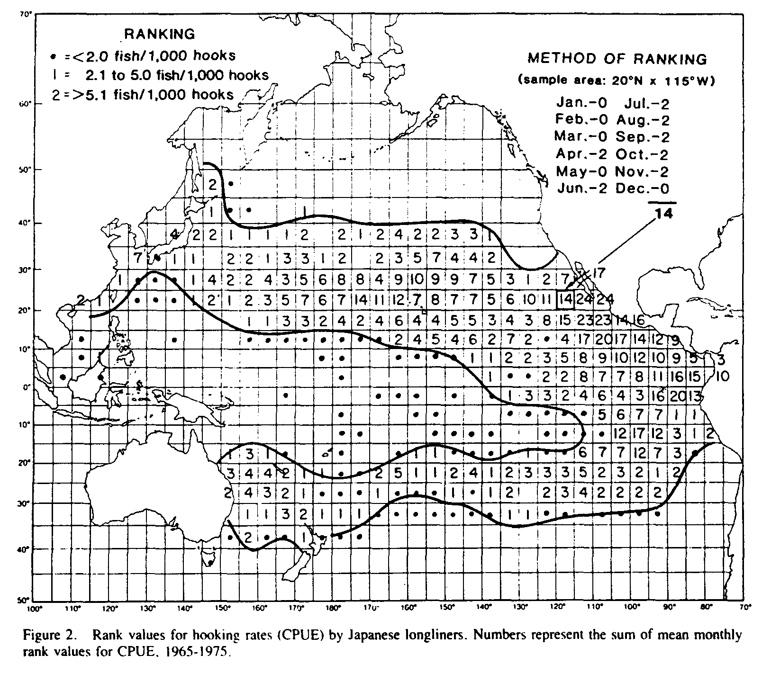
Horseshoe-Shaped Distribution of CPUE
Squire and Suzuki 1990

Slide 9
Stock Structure Information
Genetics
Tagging
CPUE
Life History
Spatial Demographics

Slide 10
Genetics
Graves and McDowell 1994
RFLP analysis of whole mtDNA
Mexico, Ecuador, Australia and Hawaii
Found significant spatial partitioning of genetic variation
Graves and McDowell 2003
Review article
Reported significant genetic heterogeneity for 3 molecular genetics techniques and 1 insignificant

Slide 11
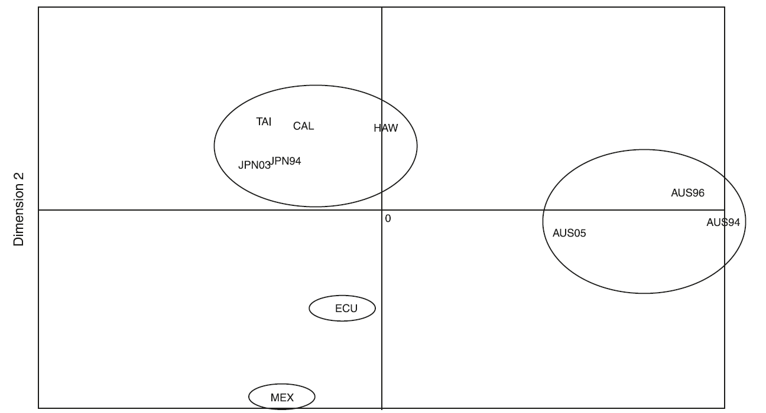
Genetics
McDowell and Graves 2008
Microsatellite and mitochondrial DNA markers
Japan, Taiwan, Australia, Hawaii, California, Mexico and Ecuador
Found significant genetic variation and spatial clusters

Slide 12
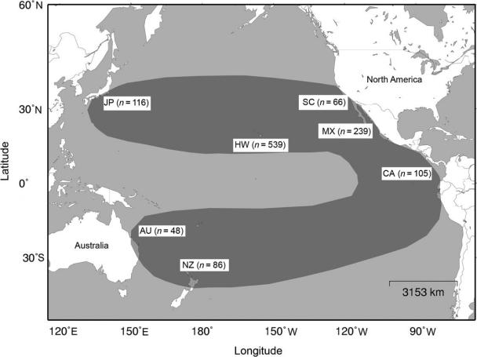
New Information: Genetics
Purcell and Edmands 2011
Microsatellite and mitochondrial DNA markers
Japan, Hawaii, Southern California, Mexico, Central America, New Zealand, and Australia

Slide 13
Genetics
Purcell and Edmands 2011
Microsatellite DNA results showed significant genetic variation and 4 groups
(1) Japan – Immature Hawaii – Southern California
(2) Mature Hawaii
(3) Mexico – Central America
(4) Australia - New Zealand
Mitochondrial DNA results showed significant genetic variation and 3 groups
(1) Japan – Immature Hawaii – Southern California - Mature Hawaii
(2) Mexico – Central America
(3) Australia - New Zealand

Slide 14
Purcell and Edmands Genetics Results

Slide 15



Striped marlin DNA sampling results
Chi Hin Lam (Tim), Clayward Tam & Molly Lutcavage
March 2021
NOAA Award - NA15NMF4270324

Slide 16
PIFG striped marlin DNA sampling efforts
Between June 27 to Aug 3, 2017, PIFG collected 148 fin clips at UFA as part of NOAA SK grant award NA15NMF4270324
Samples shared with Mark Fitchett, and later sent to CSIRO for genotyping
Results finally available in summer 2020 as a meeting paper WCPFC-SC16-2020/SA-IP-16

Slide 17
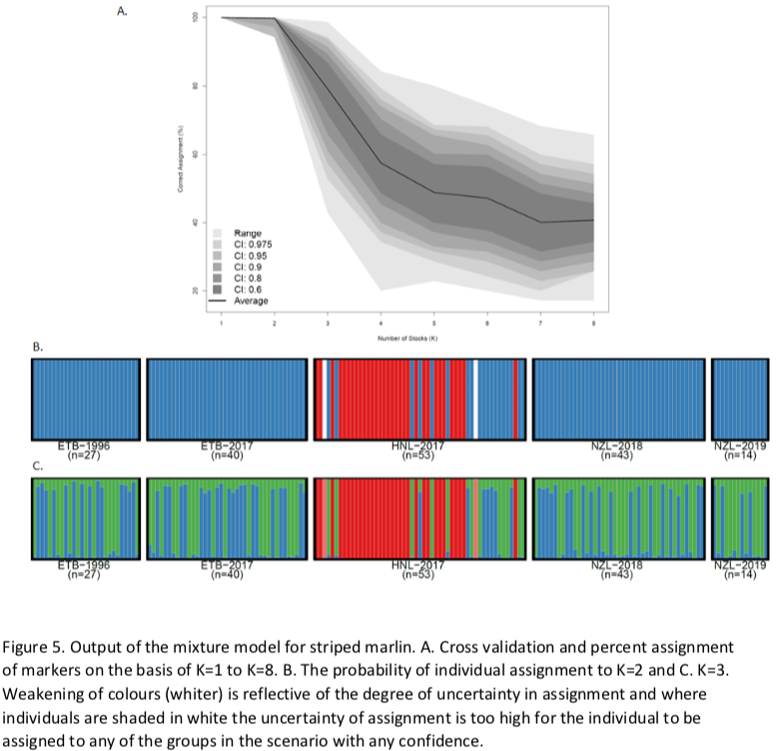
SC16-SA-IP-16 Fig. 5
53 striped marlin (est. 121-141 cm eye fork length)

Slide 18
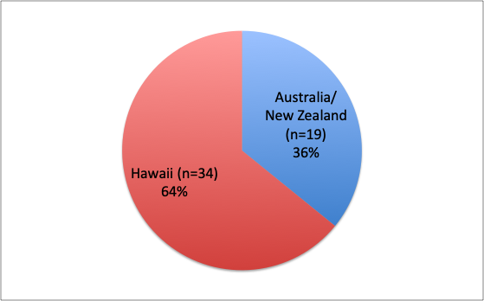
What do the results say for these Hawaii longline caught striped marlin?

Slide 19
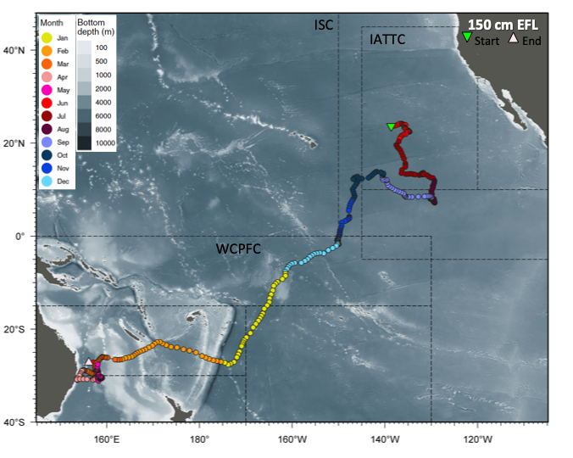
1. DNA sampled fish closed the loop on migratory movements between Central North Pacific and Australia/ New Zealand, as we first saw from our tracked fish going west.

Slide 20
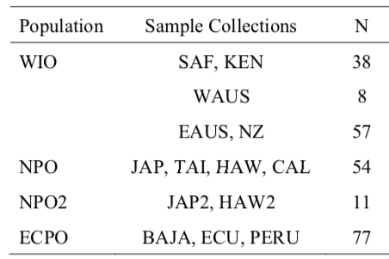
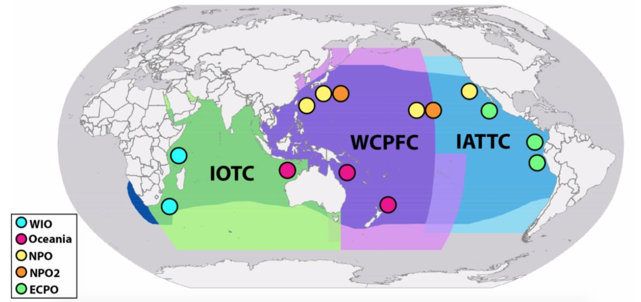
Genetics via SNPs (Mamoozadeh et al. 2018)
2. Our results reinforced earlier studies showing connectivity between Hawaii/CNP & Australia/ New Zealand, and also in larger numbers (19 vs. 4 migrants) likely because of our bigger sample size (53 vs. 21 fish)
Oceania
4 Hawaii fish (n = 21) & 3 Ecuador fish (n = 37) grouped with Oceania

Slide 21
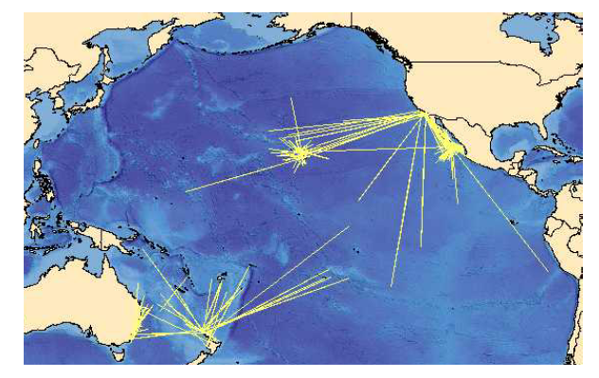
Conventional Tagging
Review of billfish tagging programs by Ortiz et al. (2003) and Bromhead and Pepperell (2004) shows striped marlin interchange between:
Hawaii and Southern California
Southern California and Mexico
Australia and New Zealand

Slide 22
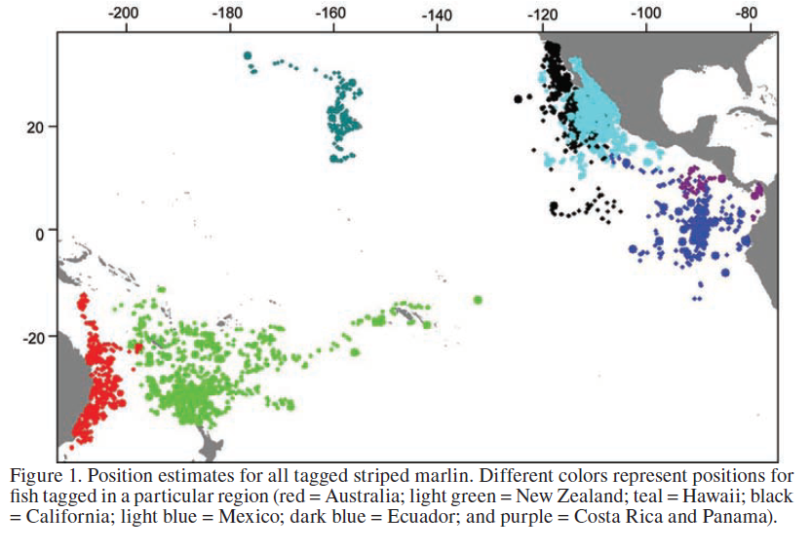
Domeier (2006) PSAT Tagging

Slide 23
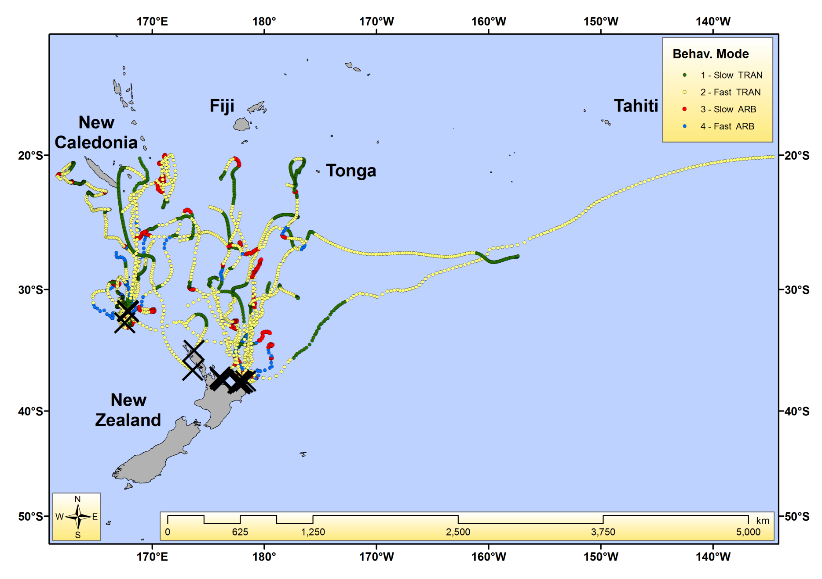
New Information: Sippel et al. (2011) PSAT Tagging

Slide 24
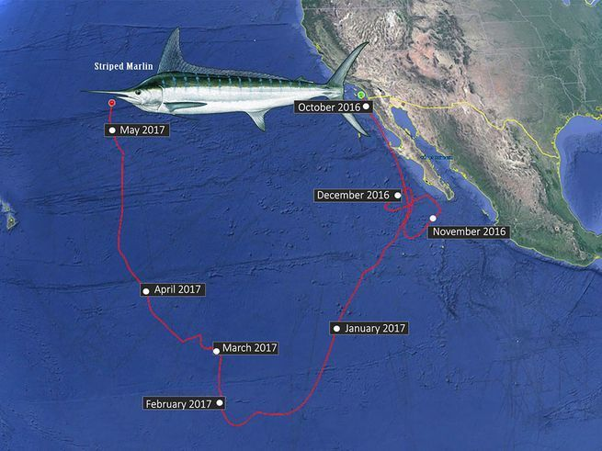
New Information: IGFA 2016 Race Winner
This 36 kg striped marlin traveled 5560 nm in 216 days

Slide 25
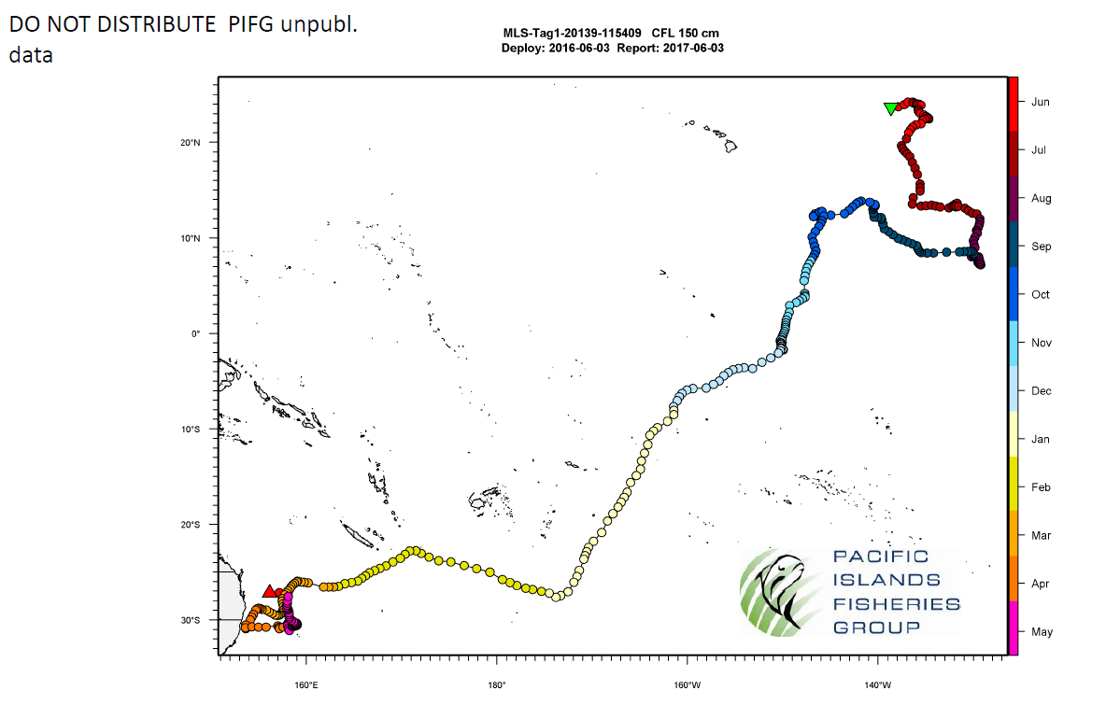
New Information: PIFG Tagging

Slide 26
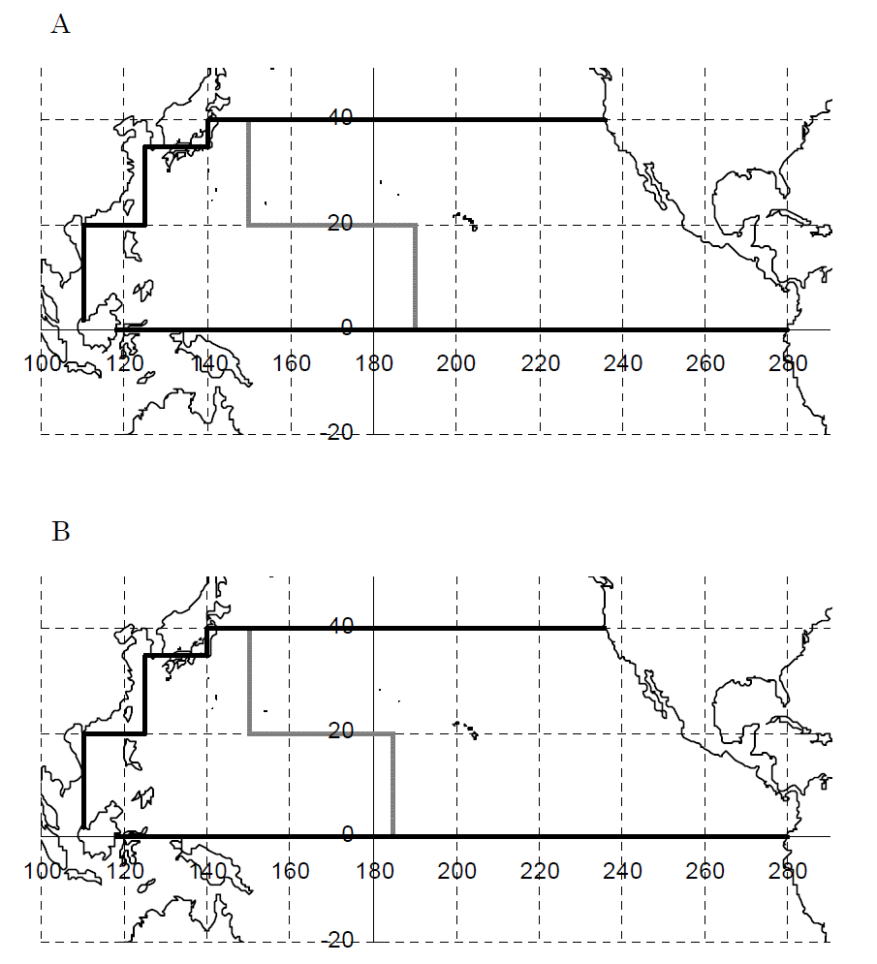
CPUE
Kanaiwa et al. (2009) ISC9_BILLWG3_WP2_Kanaiwa
Japanese longline data, 5x5 blocks, 1975-2006
Iterative Delta GLM analysis of striped marlin CPUE using AIC for model selection

Slide 27
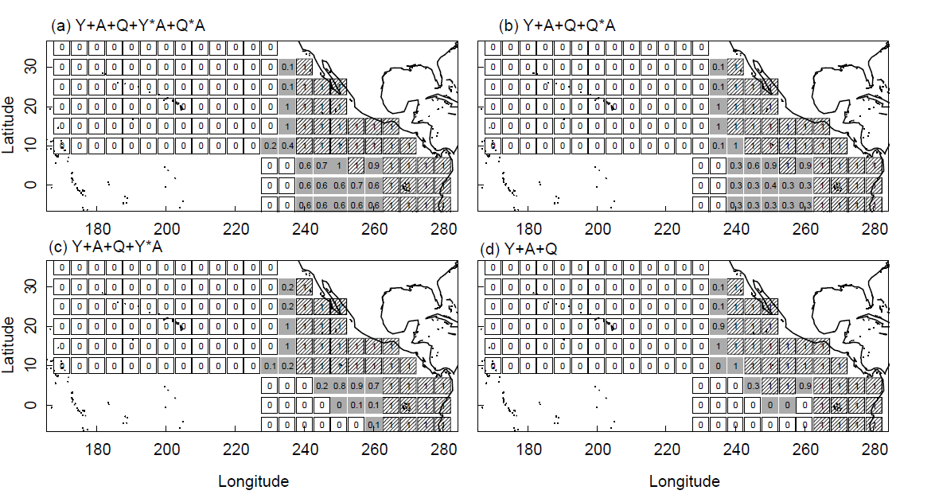
CPUE
Ichinokawa et al. (2009) ISC9_BILLWG3_WP3_Ichinokawa
Japanese longline data, 5x5 blocks, 1960-1990
(1) GLM analysis of striped marlin CPUE with alternative model structure with bootstrapping

Slide 28
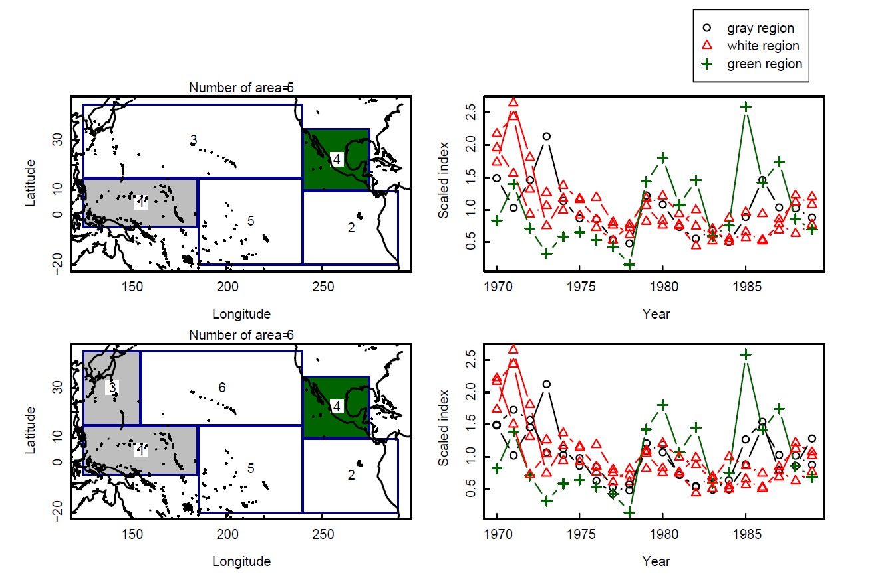
CPUE
Ichinokawa et al. (2009) ISC9_BILLWG3_WP3_Ichinokawa
Japanese longline data, 5x5 blocks, 1960-1990
(2) K-means cluster analysis of striped marlin CPUE

Slide 29
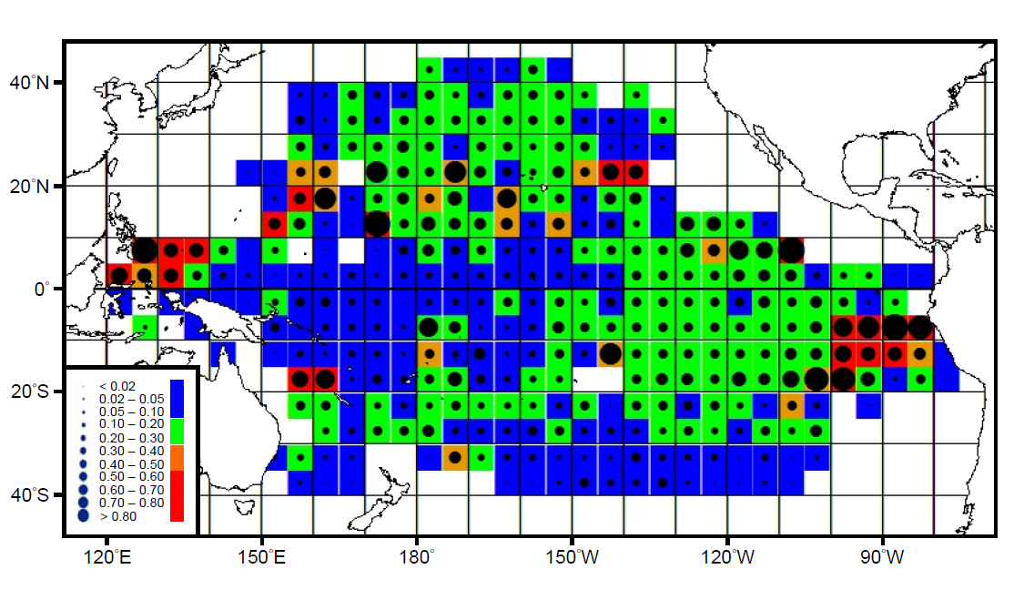
CPUE
Sun et al. (2009) ISC9_BILLWG3_WP9_Sun
Taiwanese longline data, 5x5 blocks, 1995-2007
(2) GLM analysis of striped marlin CPUE

Slide 30
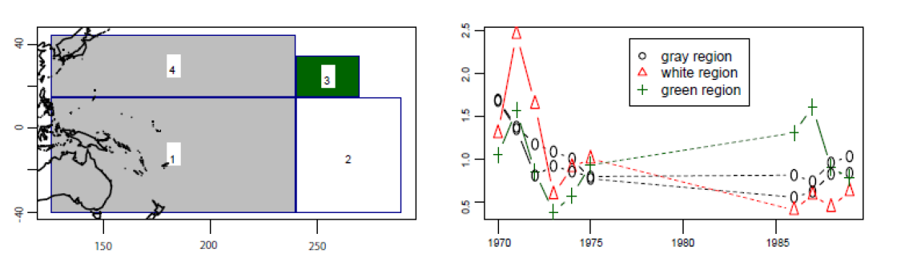
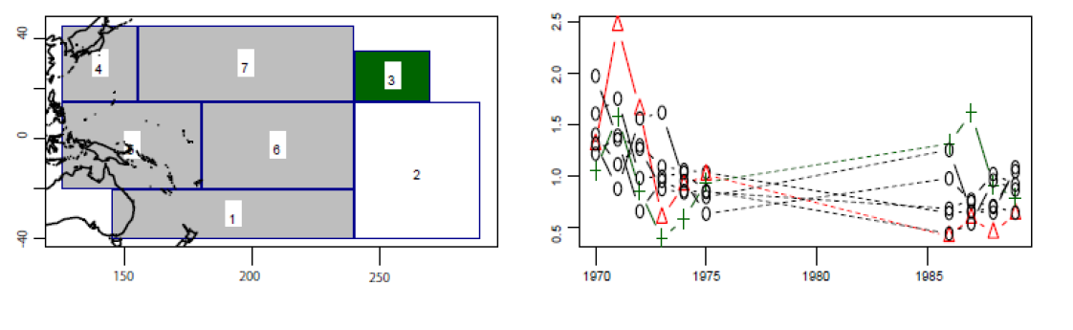
CPUE
Hosono et al. (2010) ISC10_BILLWG1_WP5_Hosono
Japanese longline data, 5x5 blocks, 1970-75 & 1986-89
Redo K-means cluster analysis of striped marlin CPUE

Slide 31
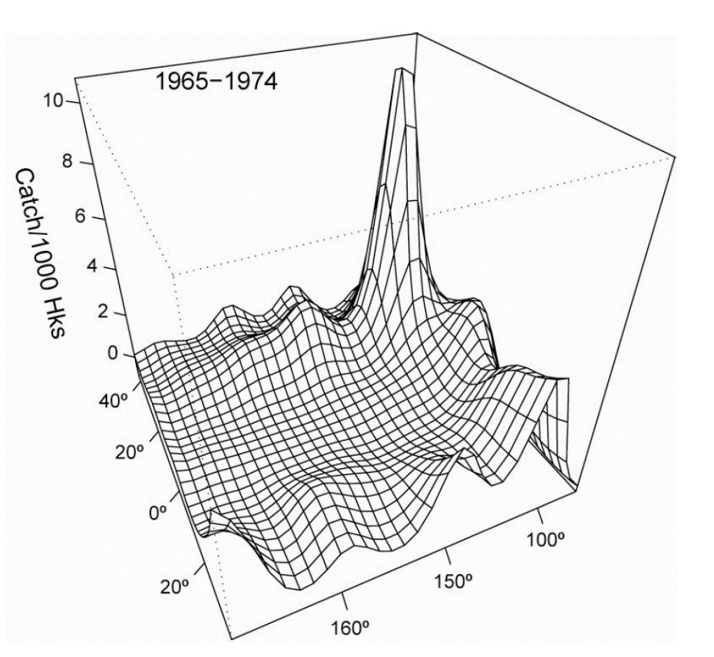
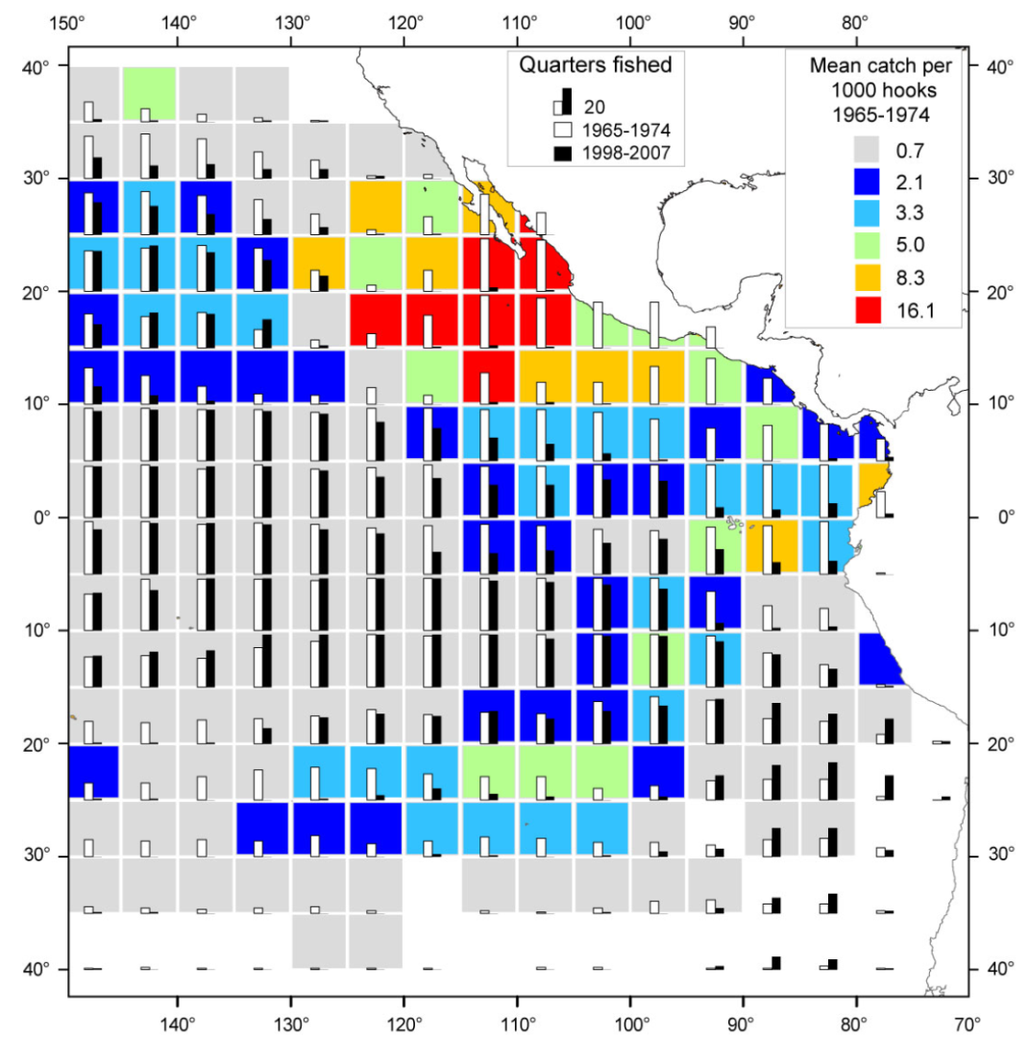
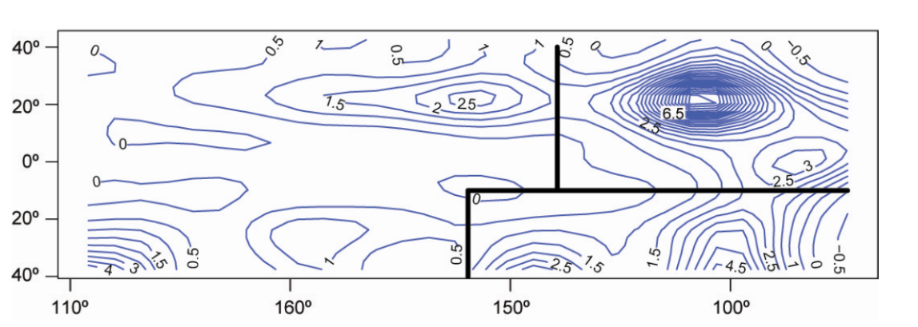
CPUE
Hinton (2008, 2009 unpub.) ISC8_SS_BILLWG_WP1_Hinton
Japanese longline data, 5x5 blocks, 1965-74, GAM analysis of Japanese CPUE

Slide 32
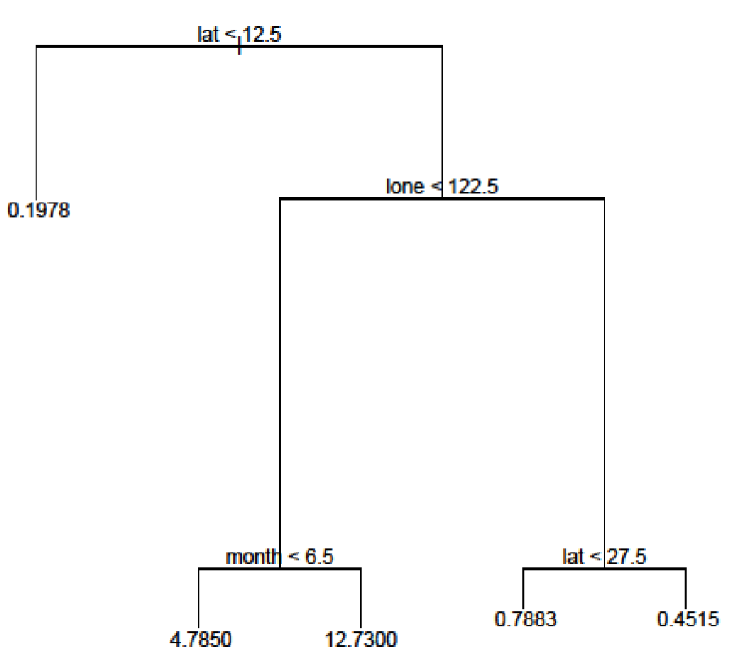
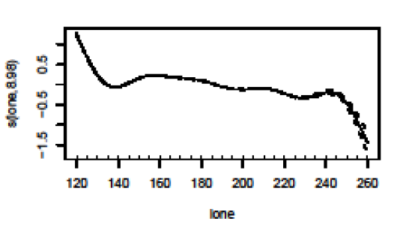
CPUE
Brodziak (2010) ISC10_BILLWG1_WP6_Brodziak
Japanese longline data, 5x5 blocks, 1975-2006
Regression tree and GAM analysis of CPUE
lone = Longitude West

Slide 33
CPUE
IATTC proposed 3 stock units with southern boundary at the equator and longitudinal boundaries at 140° W and 170° W
The WG considered all the information presented and agreed that the next stock assessment would be based on a two stock scenario hypothesis in the North Pacific Ocean. The two stocks are defined by the following boundaries:
WCPO stock- West of 140°W and north of the equator
EPO stock- East of 140°W and north of the equator
ISC (2010. ISC10_BILLWG2_Report)

Slide 34
CPUE
The WG noted that the stock boundaries attempt to isolate stock regions suggested by genetics information and identified or suggested spawning areas, as well as analyses of fisheries data.
The group also recognized that catches from any of the areas may include fish from more than one stock.
The working group acknowledges that the agreed upon stock boundaries did not completely conform to results of genetic studies.
ISC (2010. ISC10_BILLWG2_Report)

Slide 35
Seasonal Body Weight and CPUE
Ijima and Kanaiwa (2019) ISC19/BILLWG-1/WP9

Slide 36
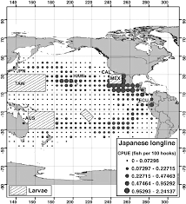
Life History: Known Spawning Areas from Bromhead and Pepperell (2004)

Slide 37
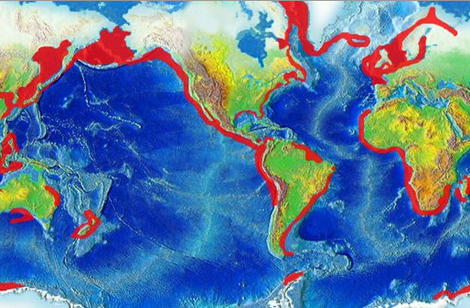
NOAA Coastal Upwelling Areas

Slide 38
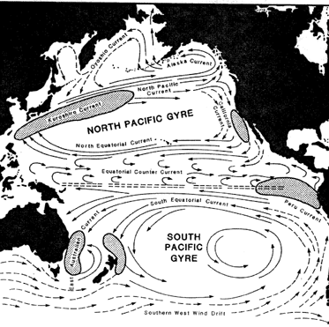
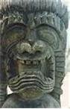
Upwelling Areas
Kanaloa

Slide 39
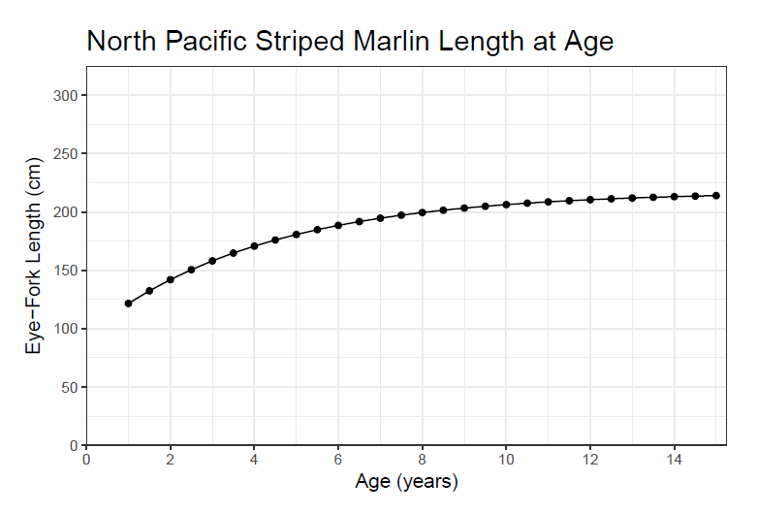
Life History: Growth in Western Central North Pacific (Sun et al 2011)
K = 0.24
Linf = 217 cm
L(1) = 122 cm

Slide 40
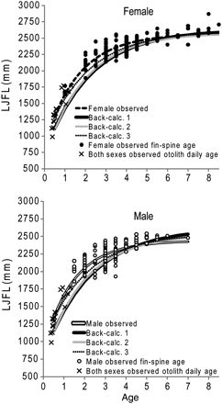
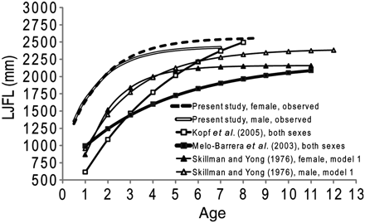
New Life History: Growth in Southwest Pacific (Kopf et al 2011)
K = 0.60
Linf = 222 cm
L(1) = 140 cm

Slide 41
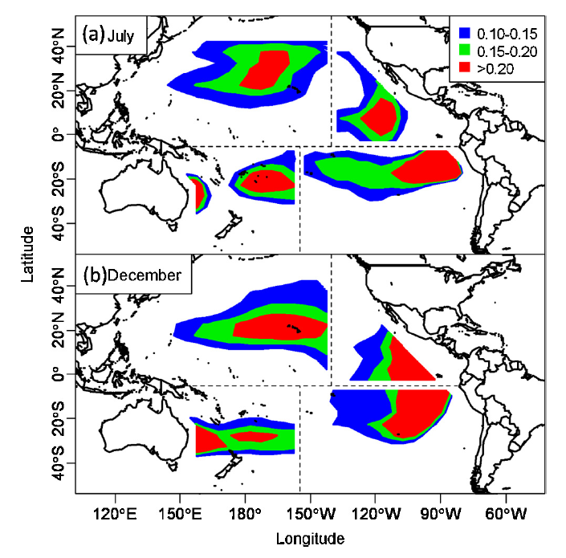
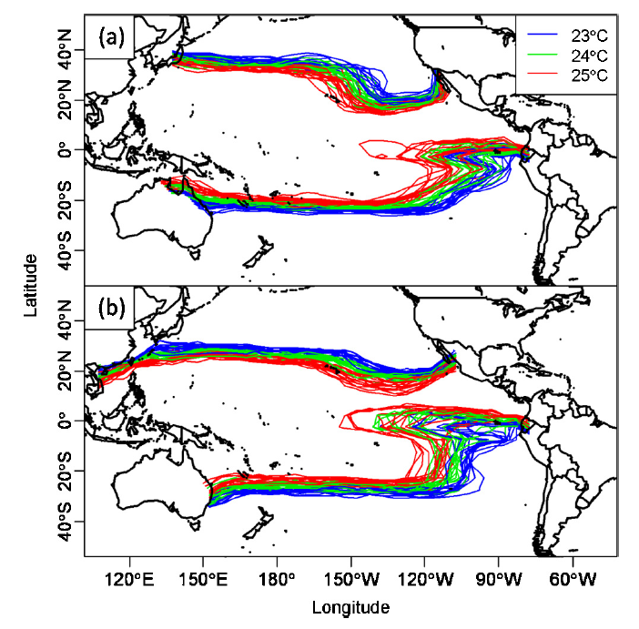
New Spatial Demographics: GAM-Based Habitat Prediction (Su et al 2015)
SST explains 27% of Deviance
SST Isotherms

Slide 42
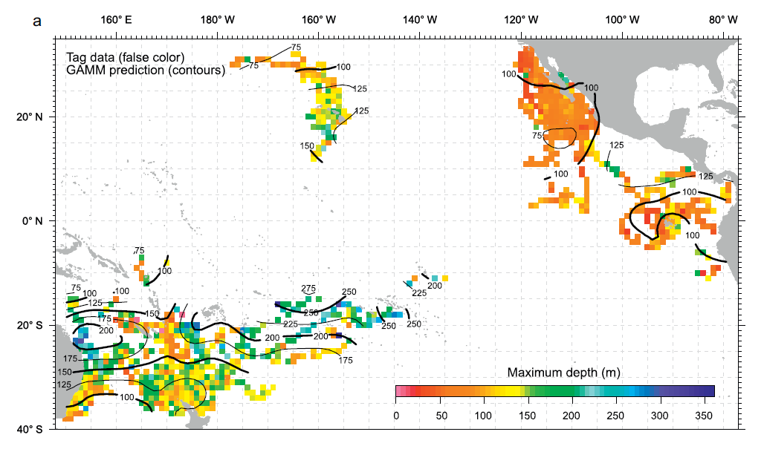
New Spatial Demographics: GAM-Based Max Depth Prediction (Lam et al 2018)
Spatial Variation in Maximum Depth

Slide 43
Striped Marlin Stock Structure To Be Used For 2019 BILLWG Stock Assessment
Use current WCNPO management unit (140° W)-No
Use entire North Pacific management unit-No
Use pan-Pacific management unit-No
Use WCPFC management unit (150° W is eastern boundary and Equator is southern boundary)-Yes!

Slide 44
WCNPO Striped Marlin Management Unit for 2019 Benchmark Assessment

Slide 45
What is a Stock ?
For fisheries applications, the term “stock” is typically defined as an
¹intraspecific group of randomly mating individuals whose demographic and genetic trajectories are mostly independent of other such groups.
¹Carvalho, G., and Hauser, L. 1994. Molecular genetics and the stock concept in fisheries. Reviews in Fish Biology and Fisheries, 4:326-350.
¹Waples, R. 1998. Separating the wheat from the chaff: Patterns of genetic differentiation in high gene flow species. The Journal of Heredity. 89:438-450.

